Slide 1

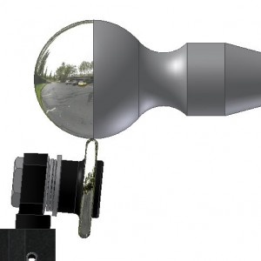
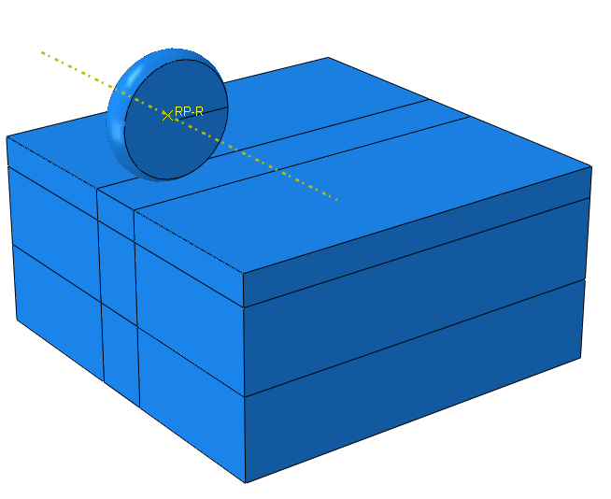

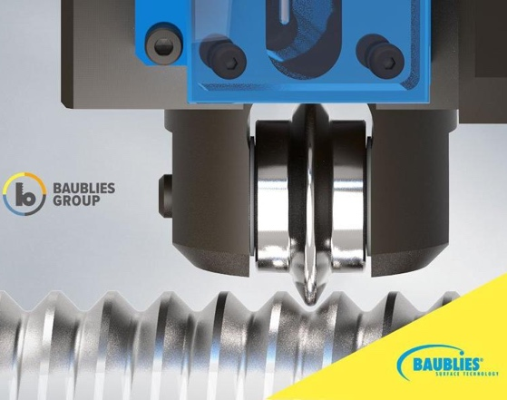

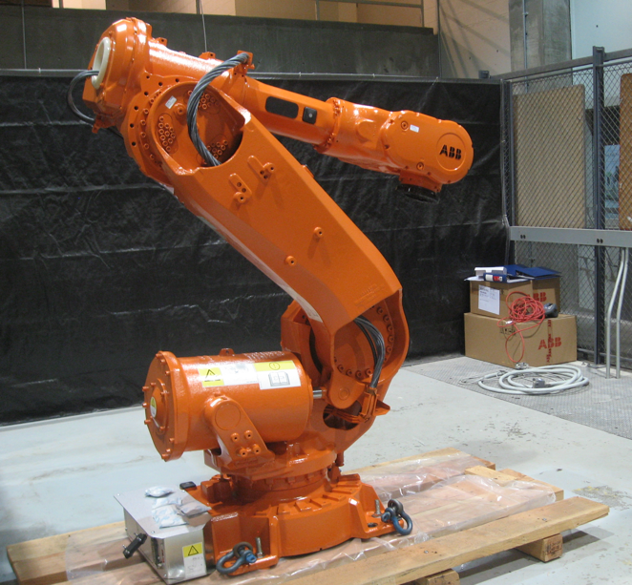
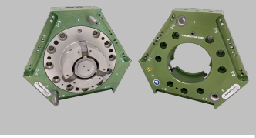
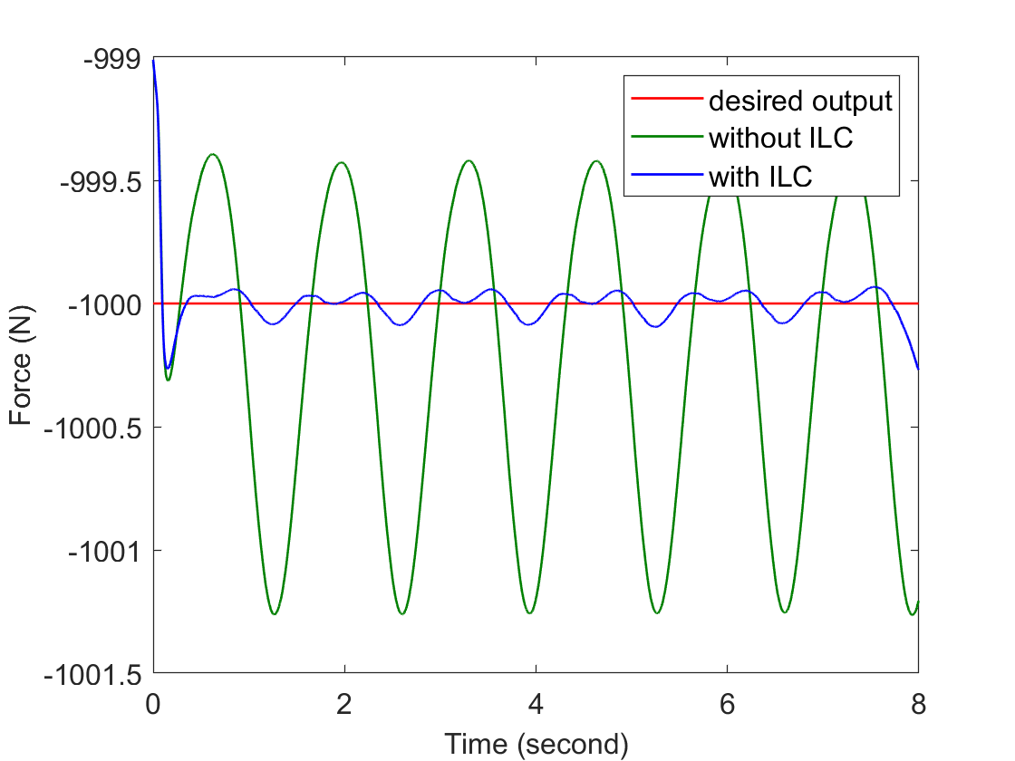
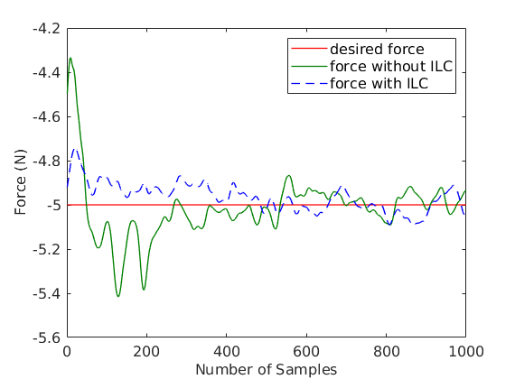
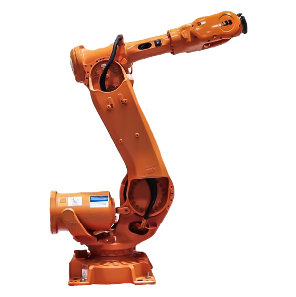
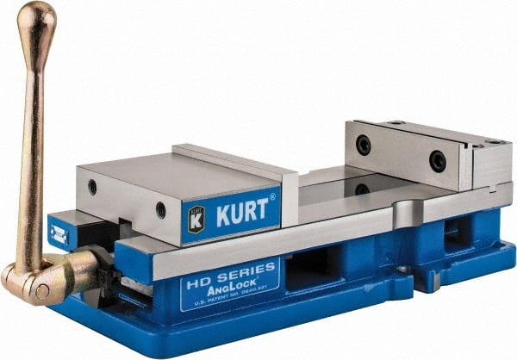
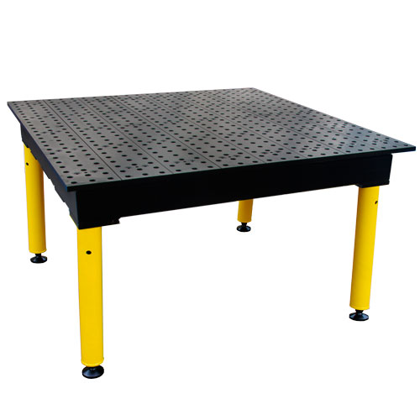
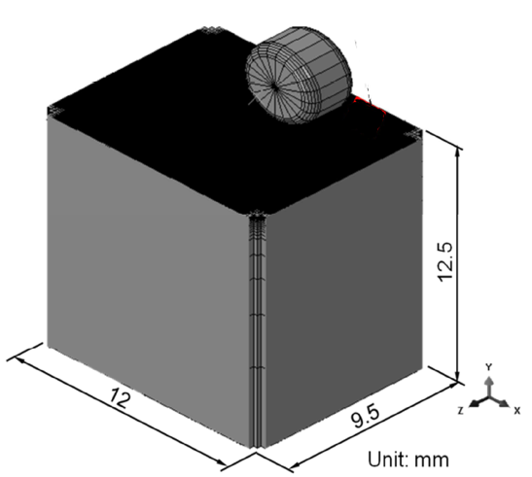
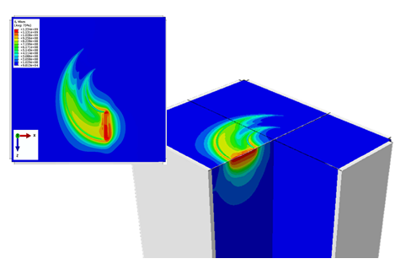
Advanced Control for Robotics Surface Treatment
ARM-19-01-F03
Abhijit Chakraborty, chakraa@utrc.utc.com, 860-610-7761
5/1/19-4/30/20
United Technology Research Center, Rensselaer Polytechnic Institute
Motivation & Background
Progress Results
Deep Rolling:
Workpiece surface exposed to high local mechanical load using a spherical or cylindrical type tool to induce work hardening and compressive residual stress
Altering mechanical behavior of material, enhancing stability of near-surface structure, reducing peak-to-peak value of surface roughness.
Robotic Deep Rolling
Compared with CNC: lower cost, higher throughput, process flexibility for parts
Large industrial robots: heavy loads, while eliminating work-envelope and motion constraints: hard-to-reach spots like corners, square-bottomed areas, and complex curvatures.
Smooth transition of forces around different geometries or segments of the part: challenging for CNC machines
FEA
Rolling on flat coupon for roller selection
Construction of simplified surface deformation model for motion/force control simulation
Iterative Learning Control
O
d
Testbed
R
Testing on RobotStudio (1D Spring Surface)
Testing on Baxter
Objectives
Apply, demonstrate, and evaluate compliance force control and iterative learning control (ILC) for deep rolling or burnishing processes using an industrial robot equipped with a roller end effector and force/torque sensor.
Project Deliverables & CDIP
Identification algorithm of robot dynamics (including joint compliance)
Robot dynamics simulation tool with contact dynamics, robot joint compliance, robot motion and force control
Co-simulation tool for combined robot motion and contact dynamics
Run-by-run Iterative motion update algorithm to improve motion/force control and microstructure objectives
Tasks & Milestones
Conclusion & Applicability
Development of integrated robot dynamics and FEA simulation for motion and force control of the deep rolling process
Development of iterative learning algorithm for hybrid motion/force control
Demonstration of applicability of hybrid motion/force control and iterative learning control to the deep rolling process
Approach extensible to other robot contact tasks: polishing, grinding, deburring
Performance Evaluation
Baseline: Existing UTRC off-line toolpath generation
Post-treatment material properties:
microstructure (surface roughness,
deformation, residue stress), fatigue
Task 1: Requirement Development (M1-M3)
- Fatigue life requirement
- Robot accuracy requirement
Task 2: Motion and Force control for Deep Rolling (M1-M5)
- Co-simulation development: ABB dynamics + UTRC FEA
- Hybrid motion/force control algorithm development
- Iterative refinement: ILC
Task 3: Development of Closed-Loop Robotic Deep Rolling Cell (M5-M8)
- RPI Testbed
- UTRC Testbed
Metrics:
Normal force: mean and stdev of normal force error
Robot tool path: mean and stdev of path tracking error
Product quality (material properties)
Cycle time
Task 4: Experimental Tests and Evaluations (M8-M10)
- Baseline case studies
- Closed loop case studies
Task 5: Project Evaluation and Reporting (M10-M12)

